Slide 1
NCCS
Cost Projection

Slide 2
Problem statement
Worst-case scenario metrics → patients not willing to undergo treatment due to cost counseling
likely due to the current structure of pricing metrics which functions by “worst case scenario costing” and fails to help customers visualize the cost in a timeline perspective.
This lack of informational awareness impedes some of these patients from getting treatment early or when it is dire. (NEED TO REPHRASE TO REFLECT: MAKING DECISION MAKING MORE INFORMED, instead of the patients didn’t know and turn away because of price)

Slide 3
Problems:
Cost counseling:
Treatment projection might sometimes have edge cases where costs are much more than the quoted cost. (Need to take into account the additional costs in a statistical fashion; i.e. after treatment, need more treatment which will cost more).
Patients need to be informed. If patients need to pay more than the quoted cost, it is very bad for the customer experience, and might affect financial planning etc. (NEED TO REPHRASE TO REFLECT: MAKING DECISION MAKING MORE INFORMED, instead of the patients didn’t know and turn away because of price)

Slide 4
Stakeholders
Patients (large amount of data on breast Cancer)
Doctors
Financial Consultants
Hospital

Slide 5
Impact
Higher possibility of patients seeking treatment
Patients are able to view the various treatment plans
Historical treatment cost and benefit data, it might help them to make better decisions on seeking treatment early

Slide 6

Why is it worth solving?
We are concerned that patients who do not undergo treatment as soon as possible will worsen their condition, resulting in even more extensive and expensive treatment further down the road.

Slide 7
Solutions
Clustering of patients to do prediction
Visualization that is based off the medical conditions that the patient has and the corresponding costs required to treat him.
Information will be shown in a timeline format that is understandable and meaningful to the patient.
Allows Doctors to have a broader view of treatment/cost considerations.

Slide 8
Solution Details:
Data: patient historical data
Backend: Python algorithm for clustering and predictive analytics.
Platform/output:
Web based.
useful views and selection models.
Cost prediction.

Slide 9
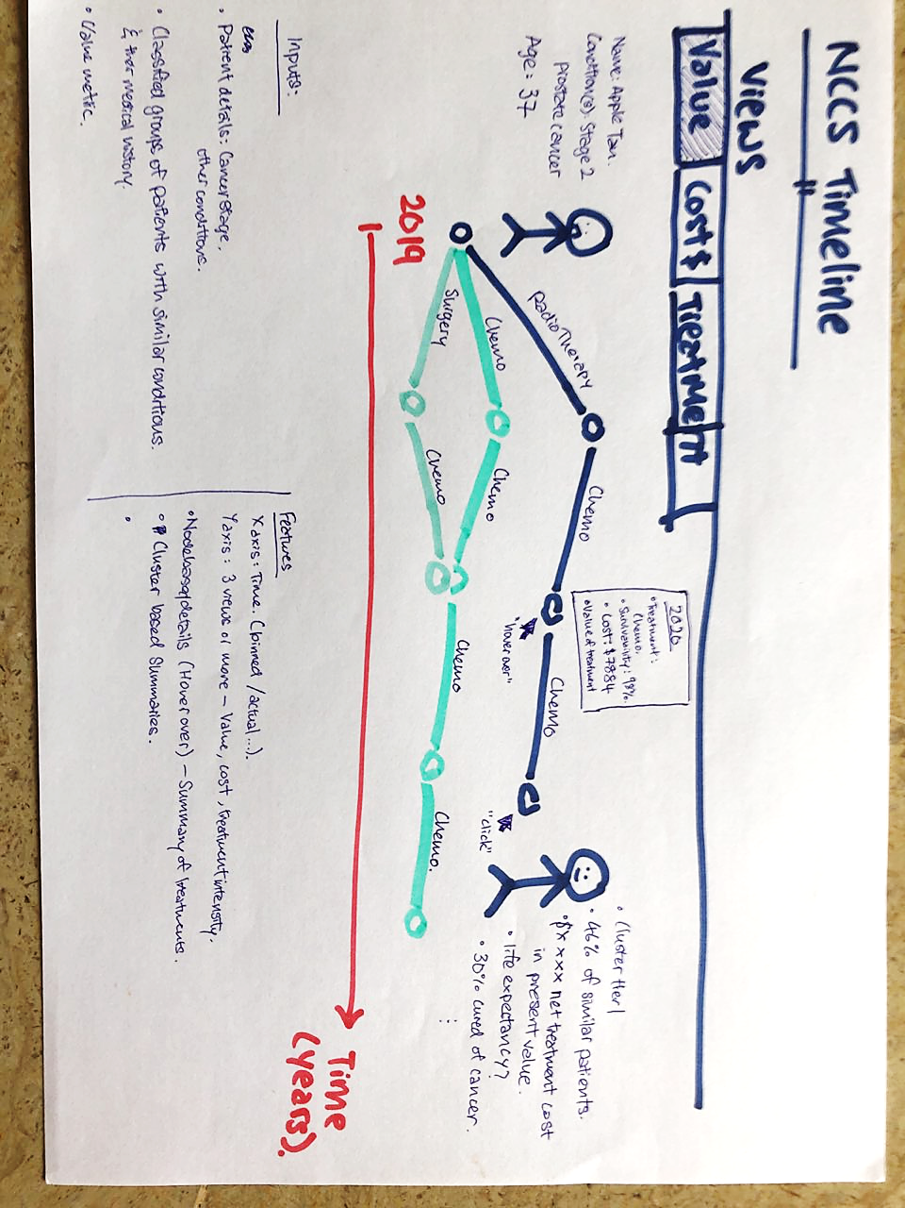

Slide 10
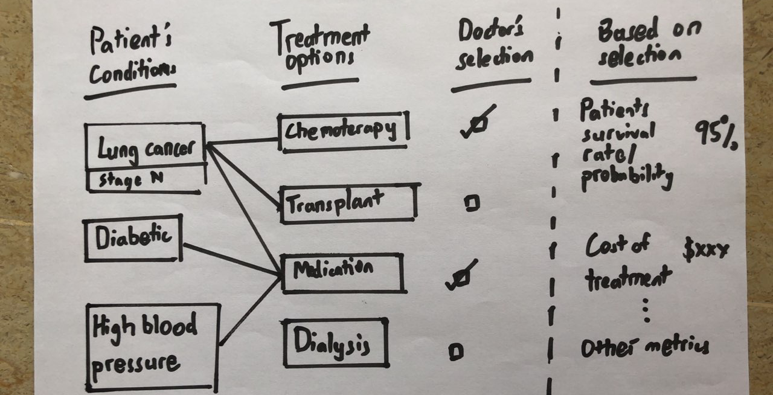

Slide 11
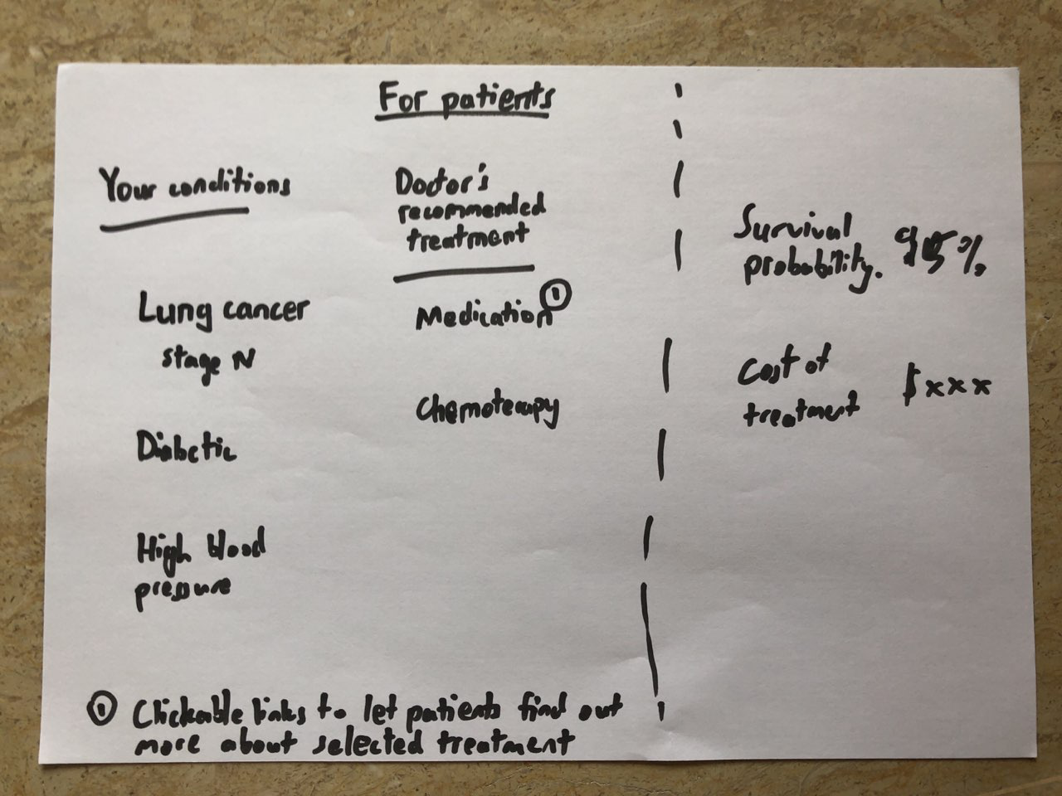

Slide 12
